Slide 1
ASP .NET MVC 5
Raghu Prasad Konandur
SME
Steller

Slide 2
Introduction
Raghu Prasad – BE, MS
Total of 27 years of experience
7 years as a lecturer in an Engineering College
20 Years into IT
Worked with companies like CISCO,CSC,ICICI,First Apex – NTT Data
Currently into Corporate training and consultancy
Worked with corporates and public sector
Service Offerings – In person/On-line/Corporate/Academic Institutes
Consultancy – Consultant to vendor of Atal Tinkering Lab/ECIL-ECIT, Incarnus – Healthcare Service Provider, Automation Spectrum Pty Ltd,Australia,Tech Varaha,Bengaluru
Technologies – Java,Python,C#,.Net,Web technologies,Java Script technologies (MEAN stack),IOT,Test Automation,Machine Learning,Artificial Intelligence,Blockchain and ERP
Corporate Customers – iLink,Sony,IQVIA,ITC Infotech,Philips,L & T,NextGen,Incarnus,Aspire system,Netwoven,SkillUpRight
Academic Customers - BGS-IT,Sindhi College,Malnad Enginering College,S B College of Management, REVA University,Nagarjuna Engineering College,Dayanand Sagar University,Acharya Institute of Technology,NIE Mysore,NIT-Imphal, AMC College, Kristu Jayanti College,SIT Tumakuru,etc

Slide 3
Topics
Introduction to ASP .NET
Why to use ASP .NET
Version history
Environmental Setup
Creating First Project
Folder Structure
Routes
Entity Framework

Slide 4
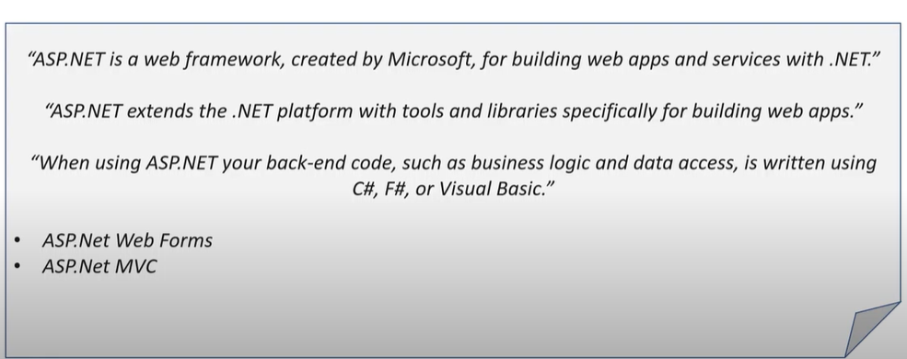
What is ASP .NET

Slide 5
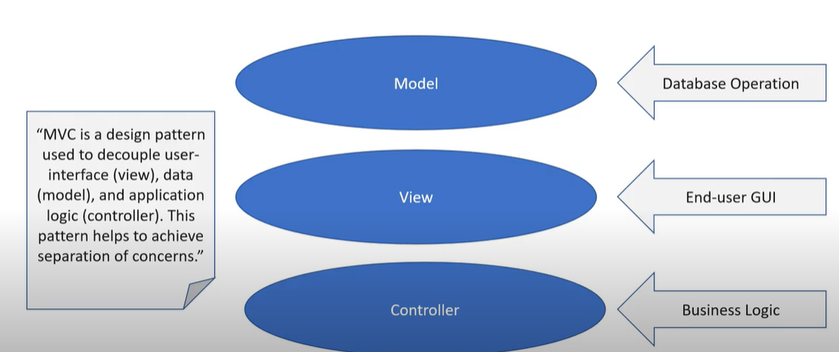
What is MVC

Slide 6
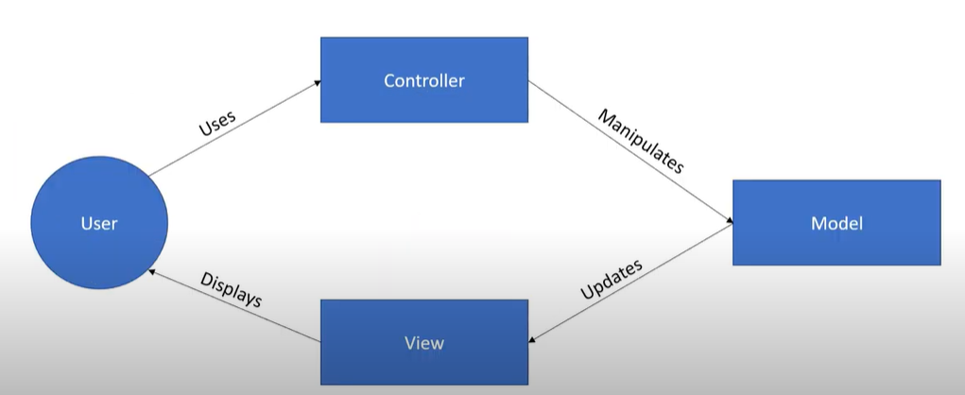
What is MVC

Slide 7
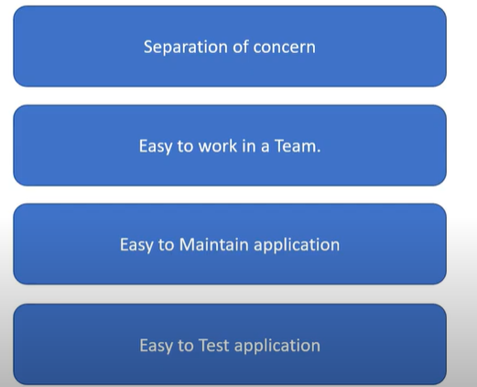
Why MVC

Slide 8
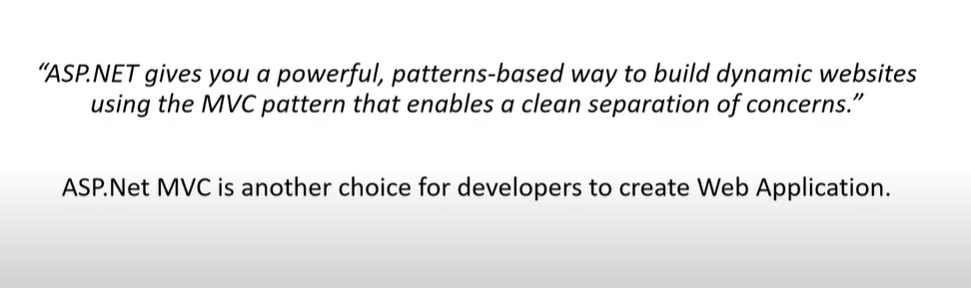
ASP.NET MVC

Slide 9
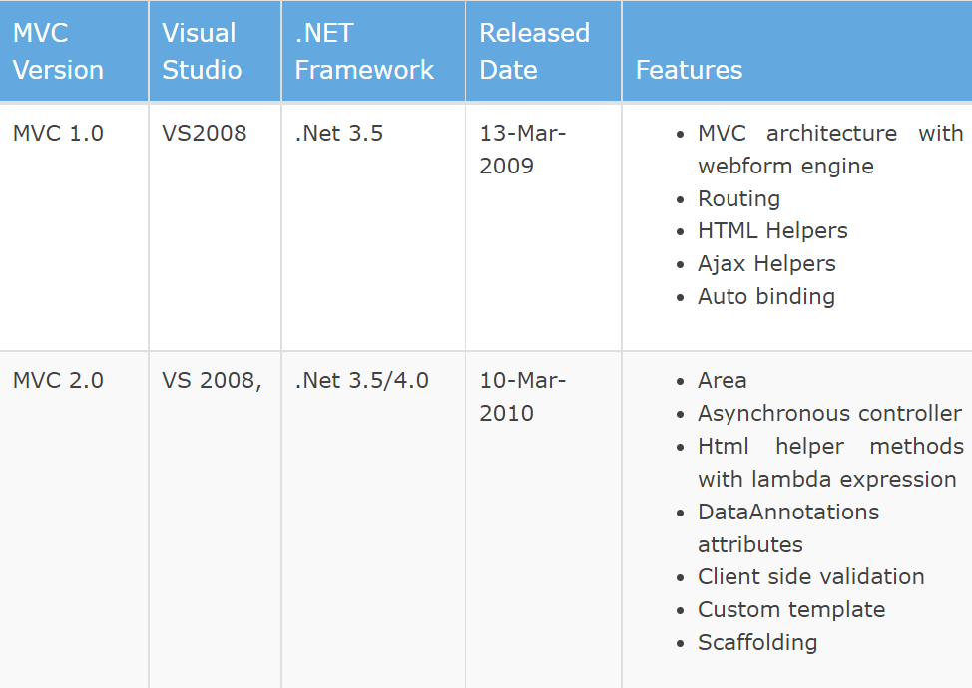
Version History of ASP .NET MVC

Slide 10
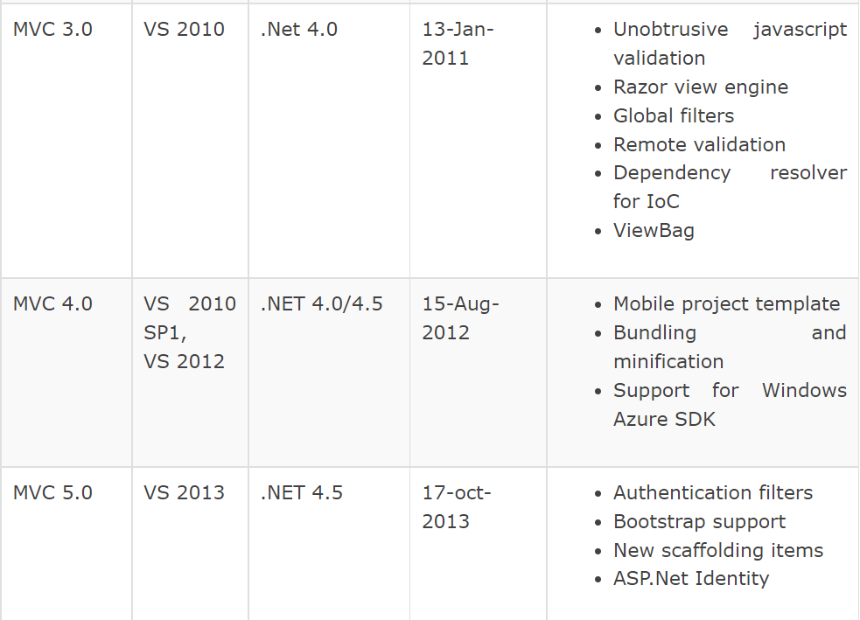
Version History of ASP .NET MVC

Slide 11
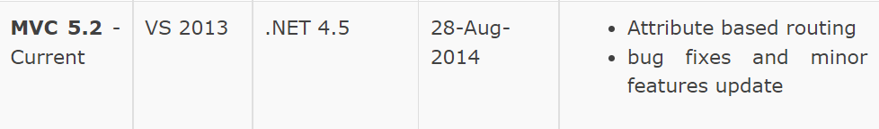
Version History of ASP .NET MVC

Slide 12
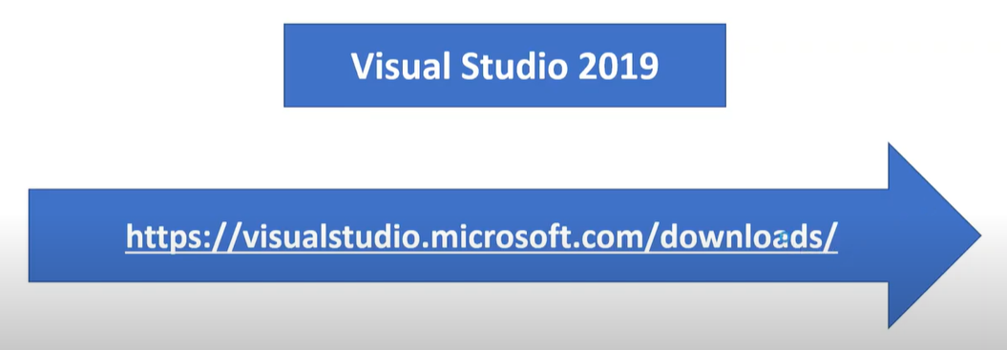
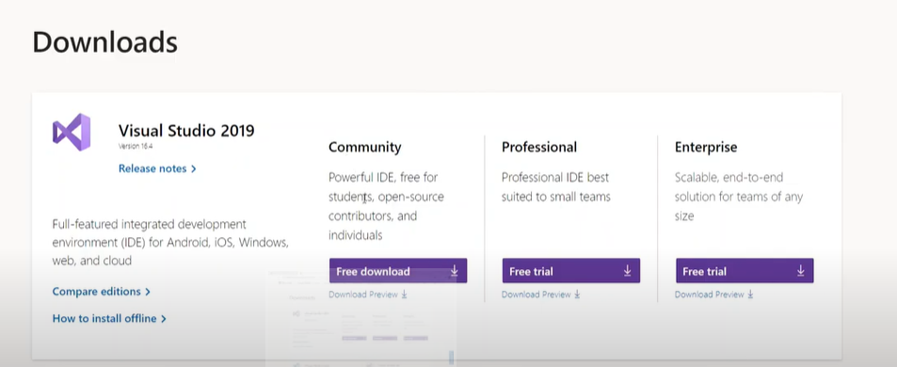
Environment Setup - IDE

Slide 13
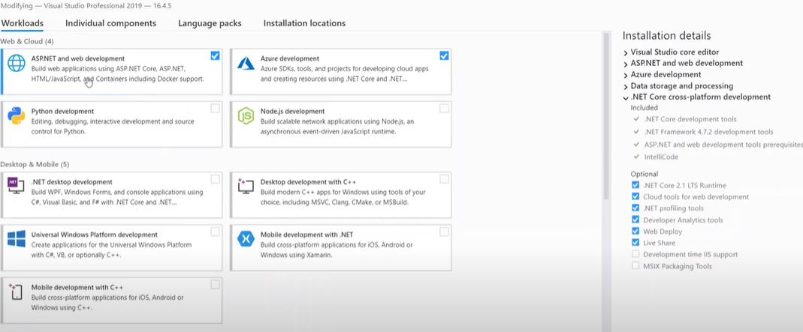
Environment Setup - IDE

Slide 14
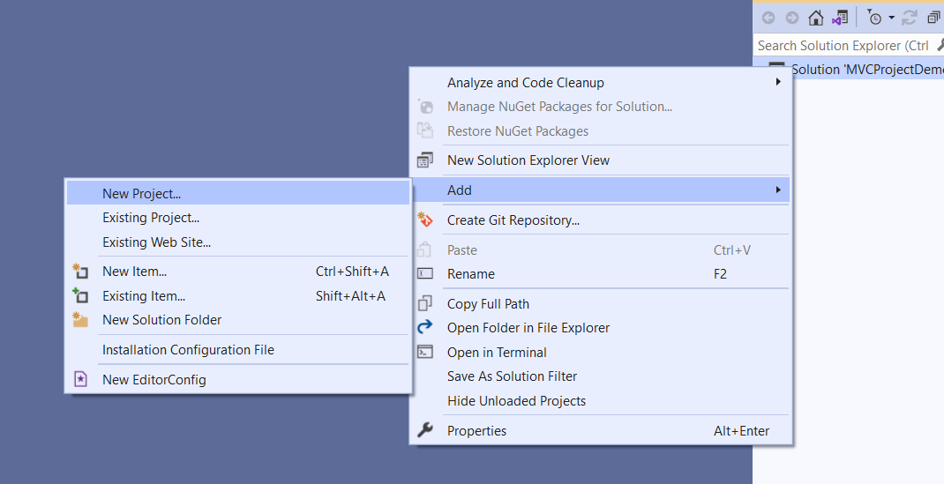
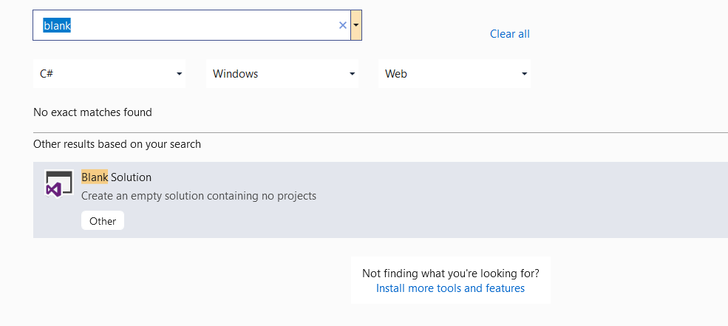
Creating First Project
Blank Solutions

Slide 15
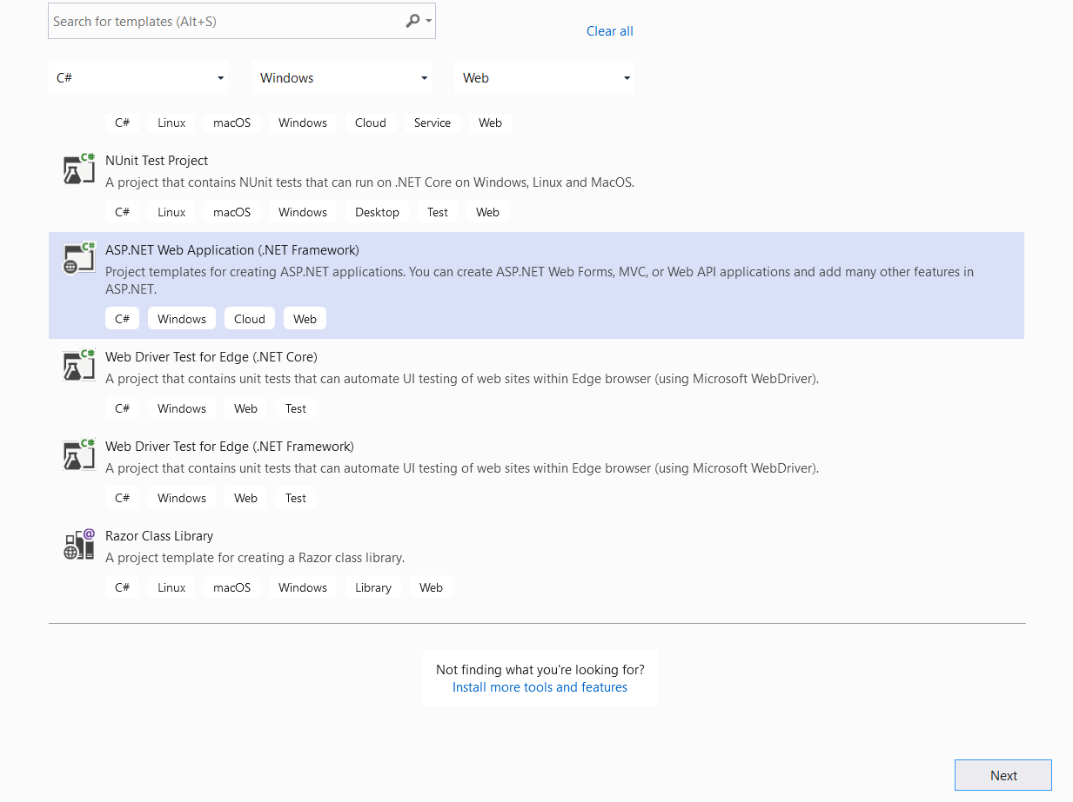
Creating First Project

Slide 16
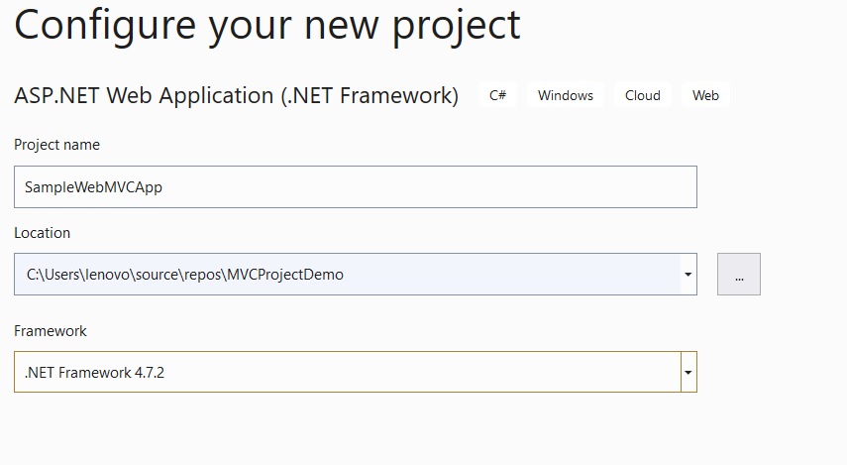
Creating First Project

Slide 17
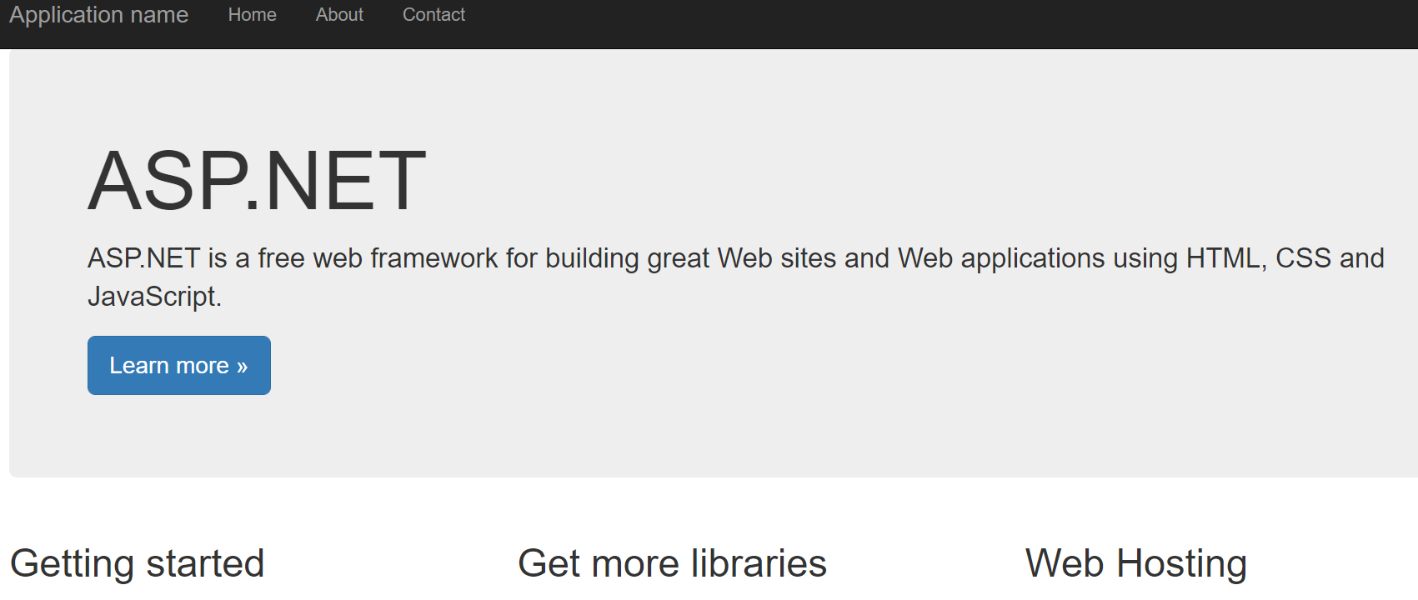
Creating First Project

Slide 18
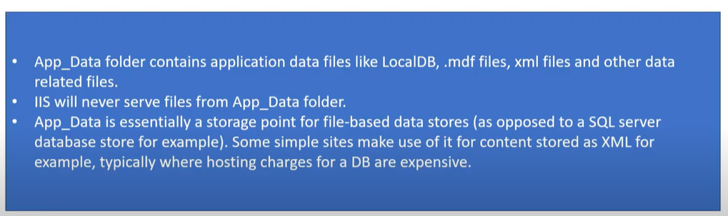
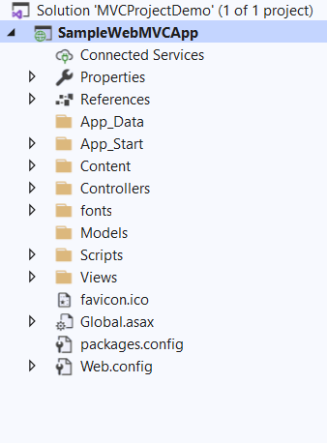
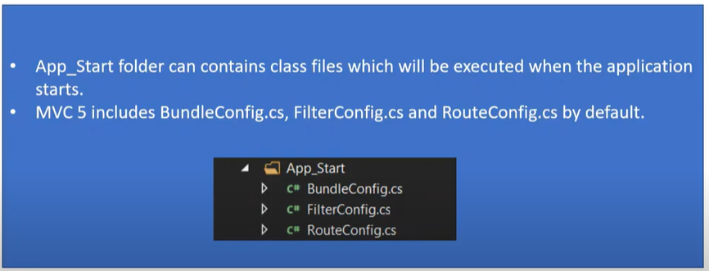
Project Structure (Folders)

Slide 19
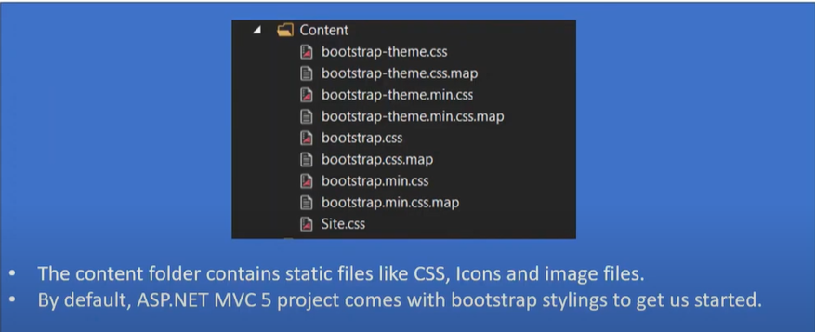
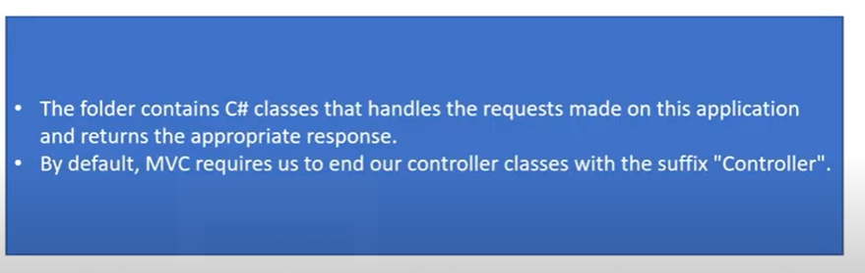
Project Structure (Folders)

Slide 20
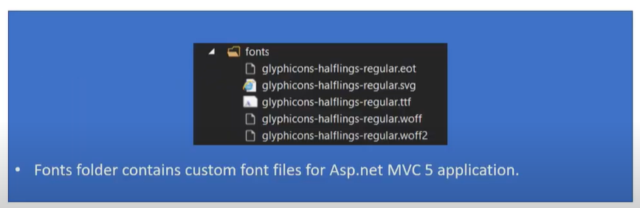
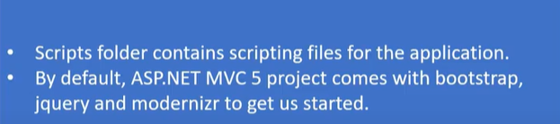
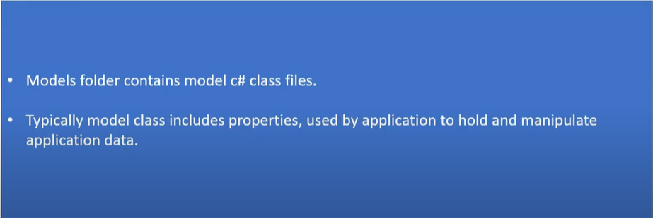
Project Structure (Folders)

Slide 21
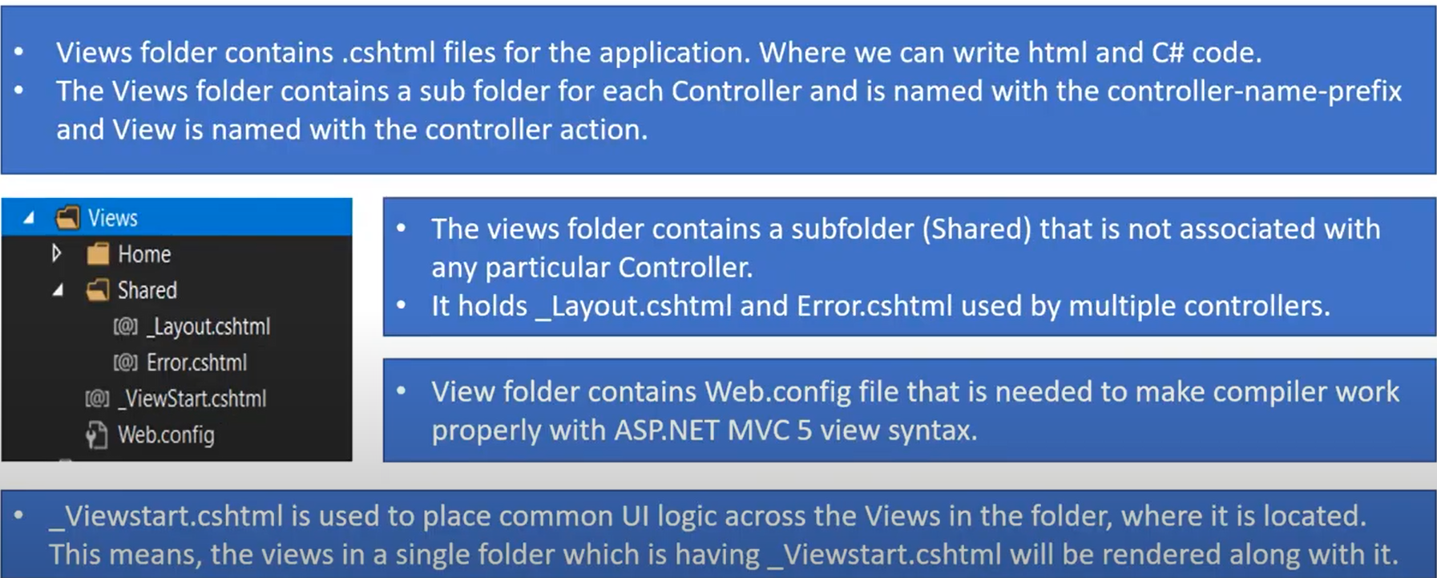
Project Structure (Folders)

Slide 22
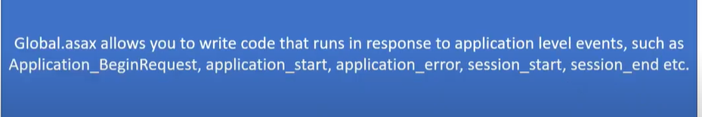

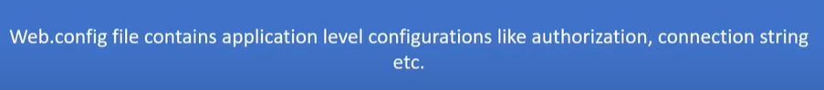
Project Structure (Folders)

Slide 23
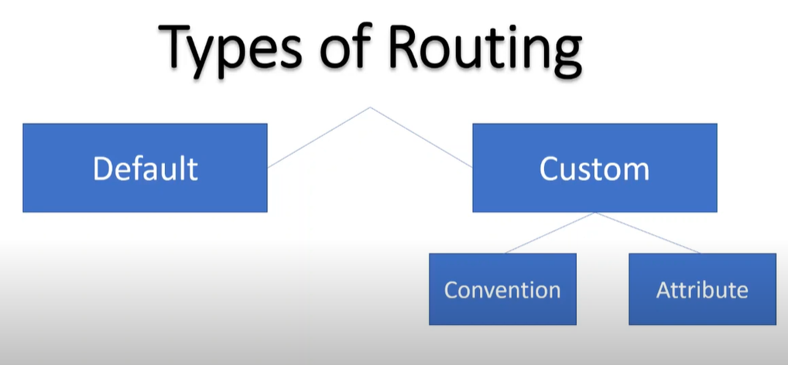
Routes

Slide 24
Entity Framework
Schema First Approach
Entity First Approach
Code First Approach

Slide 25
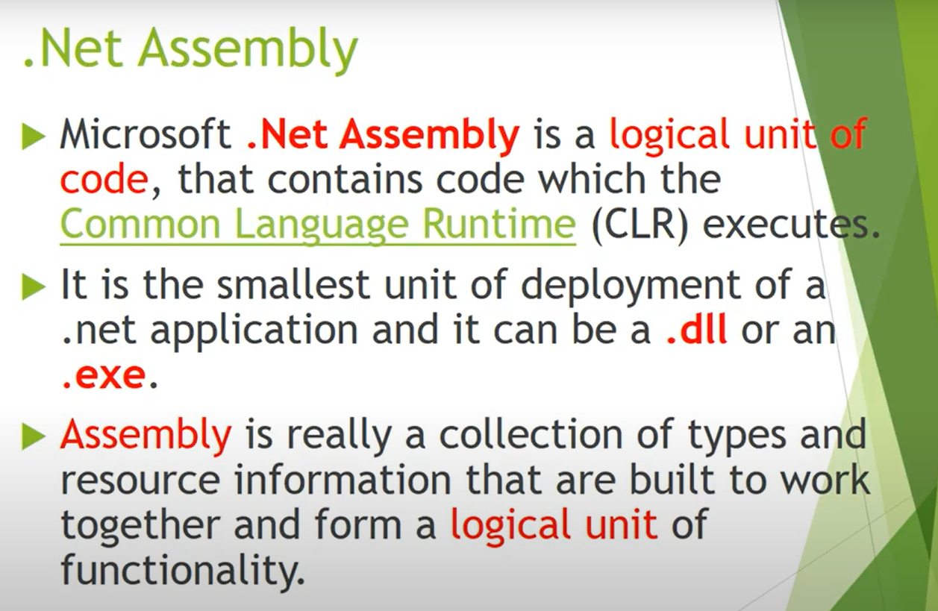
.Net Assembly

Slide 26
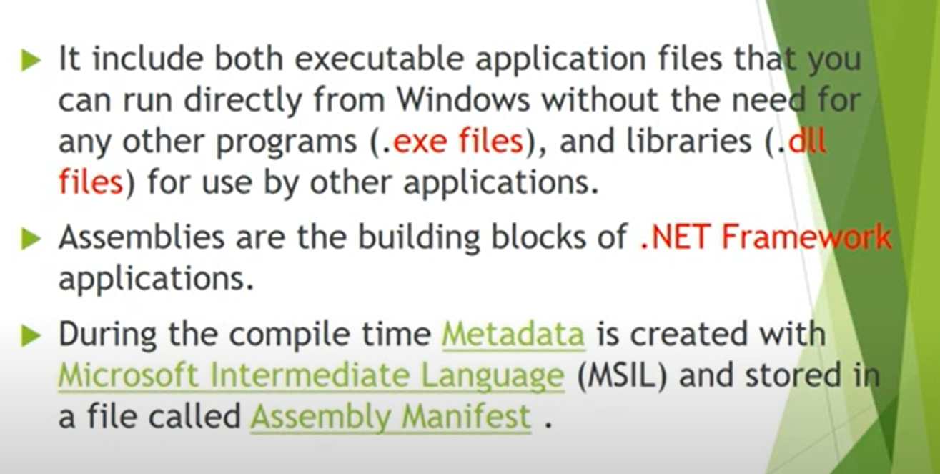
.Net Assembly

Slide 27
Thank You
Raghu Prasad Konandur
9845547471

